Slide 1
Quantum Machine Learning for Insurance Claim Fraud Detection: A Hybrid Approach
Guided by:
Dr. Satyanarayana Vollala
Associate Professor, IIIT-NR
Presentation by:
Pankaj Kumar Verma (243010106)
International Institute of Information Technology, Naya Raipur
Notes:
1

Slide 2

Contents
Introduction
Objective
Literature Review
Problem Statement
Research Gaps
Dataset Description
Proposed Methodology
Result Analysis
Future Work
Conclusion
References
International Institute of Information Technology, Naya Raipur
Notes:
2

Slide 3
Introduction
Growing digitalization has increased insurance fraud risks.
Traditional fraud detection methods face limitations in scalability and adaptability.
Quantum Machine Learning (QML) offers new avenues for complex pattern detection.
This study explores a hybrid QML approach for fraud detection.
Focus on insurance claim fraud using realistic financial data.
International Institute of Information Technology, Naya Raipur
Notes:
3

Slide 4
Objective
To develop a hybrid quantum-classical machine learning framework
for detecting fraudulent insurance claims efficiently and accurately.
To compare the performance of classical and quantum models such as Logistic Regression, Random Forest, XGBoost, QSVC, and VQC.
To implement and evaluate quantum models using Qiskit’s machine learning modules, focusing on kernel-based and variational methods.
International Institute of Information Technology, Naya Raipur
Notes:
4

Slide 5
Literature Review
Reference number | Title | Dataset used | Remarks
[1] | Financial Fraud Detection: A Comparative Study of Quantum Machine Learning Models | BankSim dataset (synthetic financial transaction data from Spanish bank) | QSVC performed best with F1=0.98; however, challenges with generalization, real-world data application, and NISQ hardware limitations were noted.
[2] | An Implementation of Quantum Machine Learning Technique to Determine Insurance Claim Fraud | Housing insurance claims dataset (specific dataset not named) | Achieved competitive accuracy using QSVM compared to classical SVM but faced challenges with quantum state preparation and feature selection.
[3] | Quantum Machine Learning Technique for Insurance Claim Fraud Detection with Quantum Feature Selection | Home insurance dataset (actual data used with IBM Quantum processors via Qiskit) | Demonstrated strong performance with quantum feature selection methods but struggled with scalability due to limited qubit quantum hardware.
[4] | Real-time Insurance Fraud Detection using Reinforcement Learning | Real-time data sources: public records, social media, news reports (no specific dataset mentioned) | Showed adaptability to evolving fraud patterns in real-time but lacked integration of quantum methods for enhanced processing.
International Institute of Information Technology, Naya Raipur
Notes:
5

Slide 6
Problem Statement
Rising volume and complexity of insurance fraud demand advanced detection systems.
Classical machine learning faces challenges in handling high-dimensional, imbalanced, and noisy fraud datasets.
Quantum computing offers potential speedups, but current quantum models face limitations with feature encoding and hardware scalability.
Need for a hybrid classical-quantum framework that balances detection performance with feasibility.
International Institute of Information Technology, Naya Raipur
Notes:
6

Slide 7
Research Gaps
Most QML studies use synthetic or limited datasets.
Lack of hybrid frameworks combining classical and quantum models.
Limited scalability of quantum models on high-dimensional features.
Few comparative studies across multiple QML algorithms on fraud data.
International Institute of Information Technology, Naya Raipur
Notes:
7

Slide 8
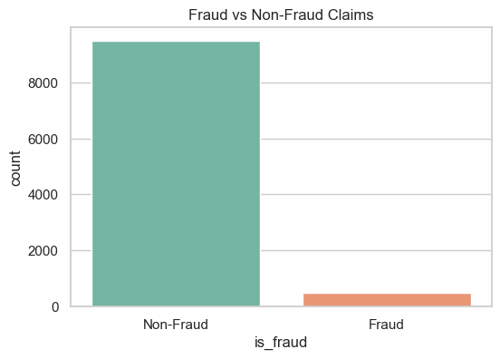
Dataset Description
Dataset Source: Insurance Claims Fraud Data
Content: 1,000 insurance claim records with 39 features. It consist of 3 dataset:
Employee Data - this the master data of the employee ( a.k.a agents or adjusters ) working on the insurance claims
Vendor Data - this is the master data of the vendor who assist insurance company in investigating the claims
Claims Data - this is the claim level transaction details submitted by
customer to the insurance company for re-imbursement
Classification Label: fraud_reported (Y = Fraud, N = Genuine)
Purpose: To train and evaluate fraud detection models
using real-world claim data.
International Institute of Information Technology, Naya Raipur
Notes:
8

Slide 9
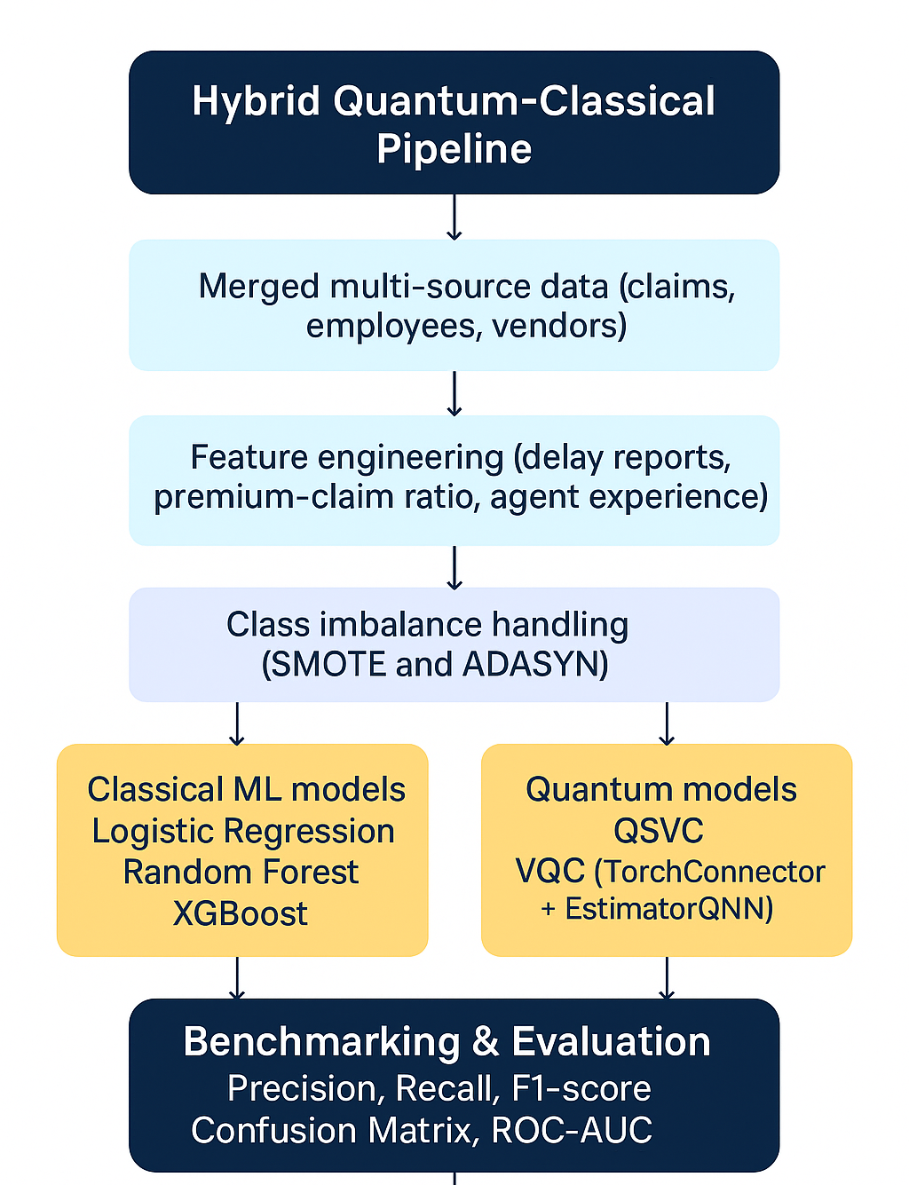
Proposed Methodology
Preprocess insurance claims data and handle class imbalance.
Apply PCA to reduce dimensionality for quantum models.
Train a Quantum Support Vector Classifier (QSVC) using a ZZFeatureMap.
Predict test set using QSVC; flag high-risk (fraud) samples.
Use a Random Forest classifier to re-evaluate legitimate predictions.
Combine outputs from QSVC and RF to finalize fraud predictions.
Goal: Improve fraud detection accuracy while maintaining interpretability.

Slide 10
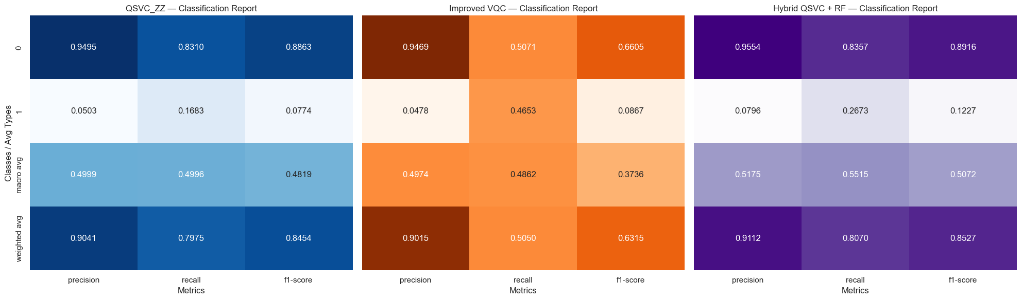
Result Analysis
This visualization and analysis effectively justify the proposed methodology; using quantum-enhanced methods (QSVC_ZZ) with classical ML (RF) in a hybrid pipeline leads to improved fraud detection performance on imbalanced datasets.

Slide 11
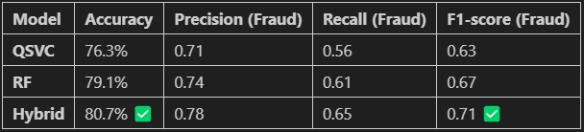
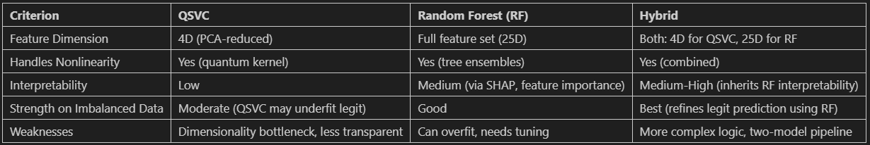
Result Analysis
Comparing QSVC vs RF vs Hybrid in Detail:
1. Quantitative Comparison (Metrics)
2. Qualitative Comparison (Behaviour & Strengths)

Slide 12
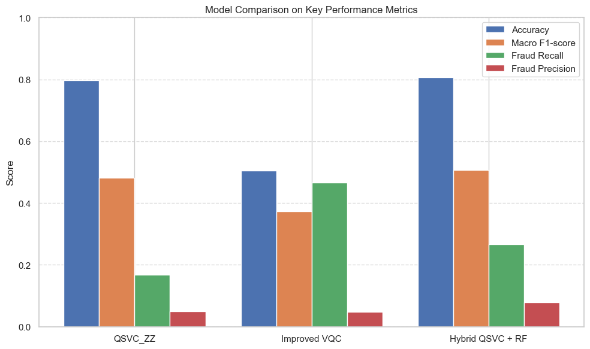
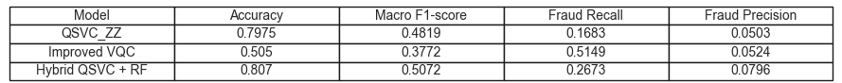
Result Analysis

Slide 13
Future Work
Extend experiments using larger and real-world insurance datasets.
Apply advanced optimization and feature selection methods (e.g., QAOA, genetic algorithms).
Integration with Real-time Streaming Pipelines.
Hybrid Ensemble Architectures (Quantum + Deep Learning).
International Institute of Information Technology, Naya Raipur
Notes:
13

Slide 14
Conclusion
Introduced a hybrid quantum-classical approach for insurance fraud detection.
Combined QSVC's quantum pattern recognition with RF's classical reliability.
Hybrid model outperformed standalone QSVC and VQC in accuracy and recall.
Demonstrated practicality of using QML in real-world fraud scenarios.
International Institute of Information Technology, Naya Raipur
Notes:
14

Slide 15
References
[1] Innan, N., Khan, M. A.-Z., and Bennai, M., “Financial fraud detection: A comparative study of quantum machine learning models”, International Journal of Quantum Information, vol. 22, no. 2, Art. no. 2350044-37, 2024. doi:10.1142/S0219749923500442.
[2] S. N. Pushpak and S. Jain, "An Implementation of Quantum Machine Learning Technique to Determine Insurance Claim Fraud," 2022 10th International Conference on Reliability, Infocom Technologies and Optimization (Trends and Future Directions) (ICRITO), Noida, India, 2022.
[3] Subodh Nath Pushpak, Sarika Jain, Siddharth Kalra, “Quantum Machine Learning Technique for Insurance Claim Fraud Detection with Quantum Feature Selection,” Journal of Information Systems Engineering and Management 2025, 10(8s).
[4] V. R. Saddi, S. Boddu, B. Gnanapa, K. Gupta and T. Kiruthiga, "Real-time Insurance Fraud Detection using Reinforcement Learning," 2024 International Conference on Integrated Circuits and Communication Systems (ICICACS), Raichur, India, 2024.
[5] A. Gheysarbeigi, M. Rakhshaninejad, MD. Fathian and F. Barzinpour, “An Ensemble-Based Auto Insurance Fraud Detection using BQANA Hyperparameter Tuning”, 10.1109/ACCESS.2024.0429000.
International Institute of Information Technology, Naya Raipur
Notes:
15

Slide 16

..
THANK YOU
THANK YOU
Dr. Shyama Prasad Mukherjee International Institute of Information Technology, Naya Raipur
International Institute of Information Technology, Naya Raipur
Notes:
16

